Slide 1
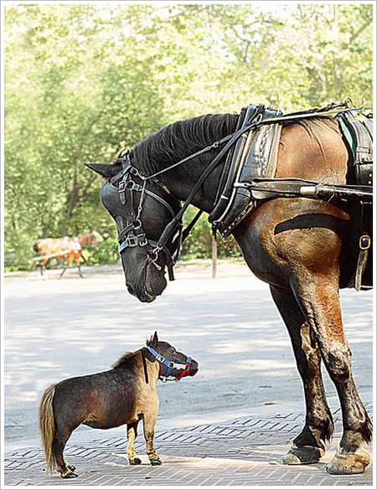
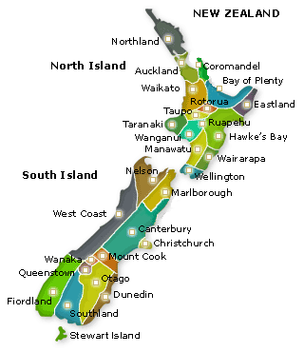
A ‘horses for courses’ approach to university governance and regional engagement
Susan Geertshuis
October 2010

Slide 2
Tertiary Education Strategy (TES) and regional engagement
 | Region(al) | Engagement
TES | 1 ($) | 1 (Maori)
Research that is relevant to and taken up by firms
Teaching what firms need
Create and share new knowledge that contributes to New Zealand’s economic and social development and environmental management’.

Slide 3
Regional (“Community”) Engagement – what is it in Auckland University
 | Community/Region(al) | Engagement | Firm
UofA Strategic plan | 13 | 10 | 0
UofA SMT roles | 0 | 0 | 0

Slide 4
Community Engagement - Strategic objective
The University has a distinctive part to play in dissemination of research, encouragement of innovation and application of advanced thinking and learning that impact positively on our economy, society, culture and environment.
Objective 11 Develop effective partnerships with the University’s local, national and international communities.
Objective 12 Engage alumni and friends in mutually supportive and productive relationships.

Slide 5
So what?
Government not funding or driving with engagement with any vigour – expect relevance to firms and dissemination
University – no co-ordinated strategy or clear or comprehensive targets/ambitions (except for Maori and Pasifika participation)
...............AND YET WE DO ENGAGE!!!!

Slide 6
Approaches to effective governance
(CVF- Quinn and Cameron)
Clan based /Professional governance
Collective
Collegial
Professional
Adhocracy/ Networked governance
Independent
Adhocracy
Flexible
Internal focus
External focus
Hierarchical governance
Controlled
Market Governance
Invisible hand
Stable

Slide 7
Widening Maori Participation
Professional
Collective
Collegial
Adhocracy
Independent
Flexible
Internal focus
External focus
Hierarchy
Controlled
Market
Invisible hand
Stable

Slide 8
Auckland UniServices Limited is the largest research and development company of its kind in Australasia
Clan
Collective
Collegial
Adhocracy
Independent
Flexible
Internal focus
External focus
Hierarchy
Controlled
Market
Invisible hand
Stable

Slide 9
Community Education
450 non credit courses and 10,000 enrolments each year. + events, conferences and contract training.
Clan
Collective
Collegial
Adhocracy
Independent
Flexible
Internal focus
External focus
Hierarchy
Controlled
Market
Invisible hand
Stable

Slide 10
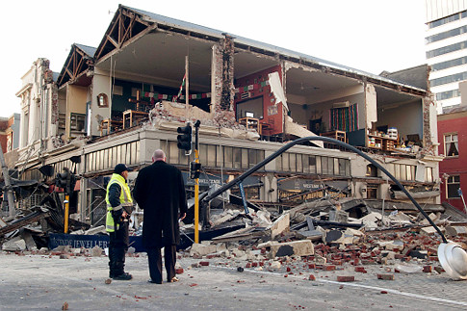
Critic and Conscience
Clan
Collective
Collegial
Adhocracy
Independent
Flexible
Internal focus
External focus
Hierarchy
Controlled
Market
Invisible hand
Stable

Slide 11
Engagement | Category | Benefits? | Leaders need to... | Regular academics need to...
Maori participation | Hierarchy | Control, Organised/ manage risks | Know what they want and how to get there | Follow process/fit in/
Commercialisation and wealth creation | Adhocracy | Innovative/ opportunistic | Support/ let go/tolerate failures | Compete/ Create/Make decisions
Community Education | Market | Lean and keen/ | Allow market to lead/ be business managers | Compete/ achieve targets
Critic and conscience | Professional | Creative/ Innovative/ organic | Trust/Support | Make decisions

Slide 12
Thank you

