Slide 1
Creating Community Engagement

Slide 2
Purpose
To put more University in the Community and
more Community into University

Slide 3
Introduction
Community engagement is replacing ‘service’ as the third
major element in university strategic planning
A number of academics world-wide are becoming interested
in how best to carry out community engagement

Slide 4
Key Elements
Exchange rather than ‘one way’
Community Service Learning
Engaging ‘undersubscribed audiences’
  New citizens
  Aboriginal Peoples

Slide 5
Overview
To be instrumental in the delivery of UBC-wide activities
which speak to the goals and directions of the University
Act as a catalyst in the development of content which will
increase community engagement both inside and outside UBC
Spearhead the development of the community aspects of
the Cultural Precinct
Spearhead a strong UBC partnership with the Musqueam
Nation and other First Nations throughout the province

Slide 6
The Key Programs

Slide 7
The Lectures:
UBC-Laurier Institution Multiculturalism Lecture
One of the key elements of Canada is the increased immigration
and increased multiculturalism
UBC-Laurier Institution Multiculturalism Lecture celebrates
Canada’s diversity by examining the various aspects of today’s
multicultural society and brings together speakers from many
cultural backgrounds who share their views as Canadians

Slide 8
The Lectures:
UBC-Laurier Institution Multiculturalism Lecture
Wayson Choy 2010 - Navigating Multicultural Realities
John Ralston Saul 2009 - The Aboriginal Peoples and New Canadians:
The Missing Conversation
Will Kymlicka 2008 - The Three Lives of Multiculturalism
Karim H. Karim 2007 - Pundits, Pachyderms and Pluralism: The Never
Ending Debate on Multiculturalism
Leonie Sandercock 2006 – Mongrel Cities of the 21st Century: Is
Multiculturalism the Solution or the Problem?
Roy Miki 2005 – Issuing Redress: Personal and Critical Perspective
Mina Shum 2004 – New Day Rising: Journey of a Hyphenated Girl

Slide 9
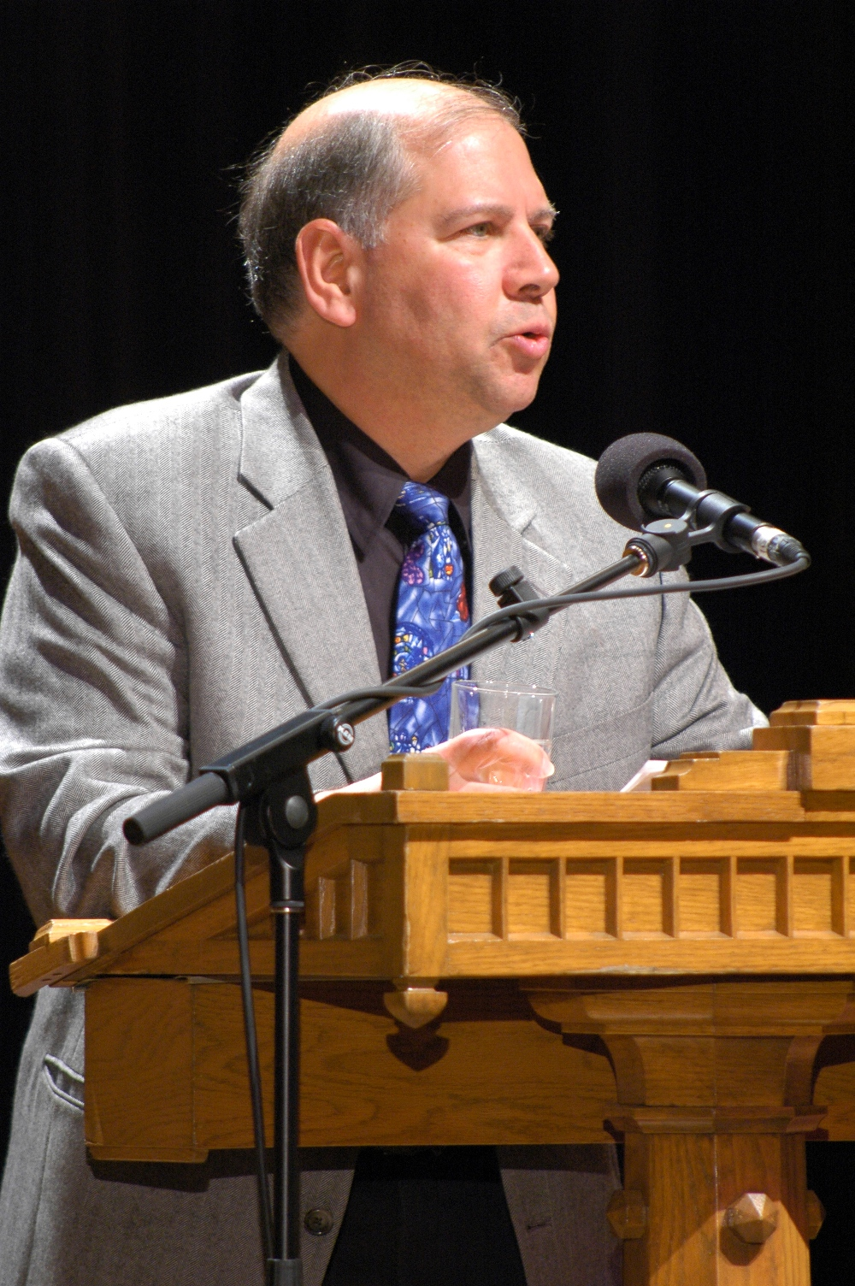
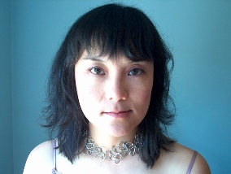
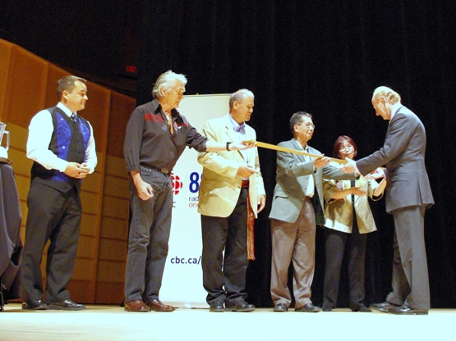
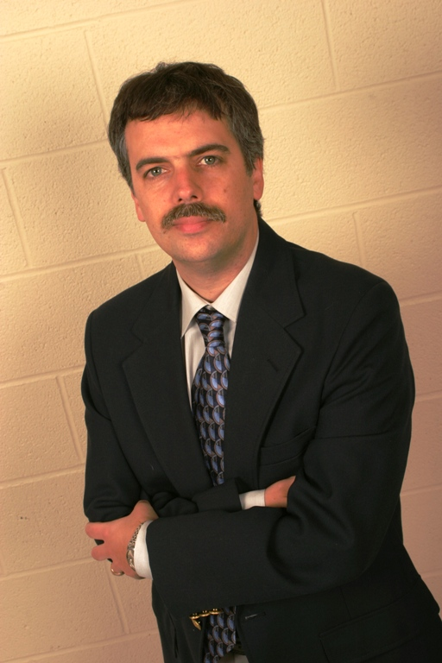
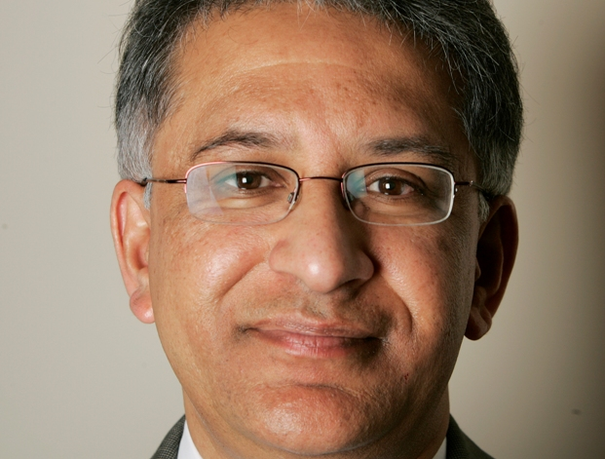
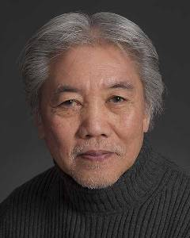
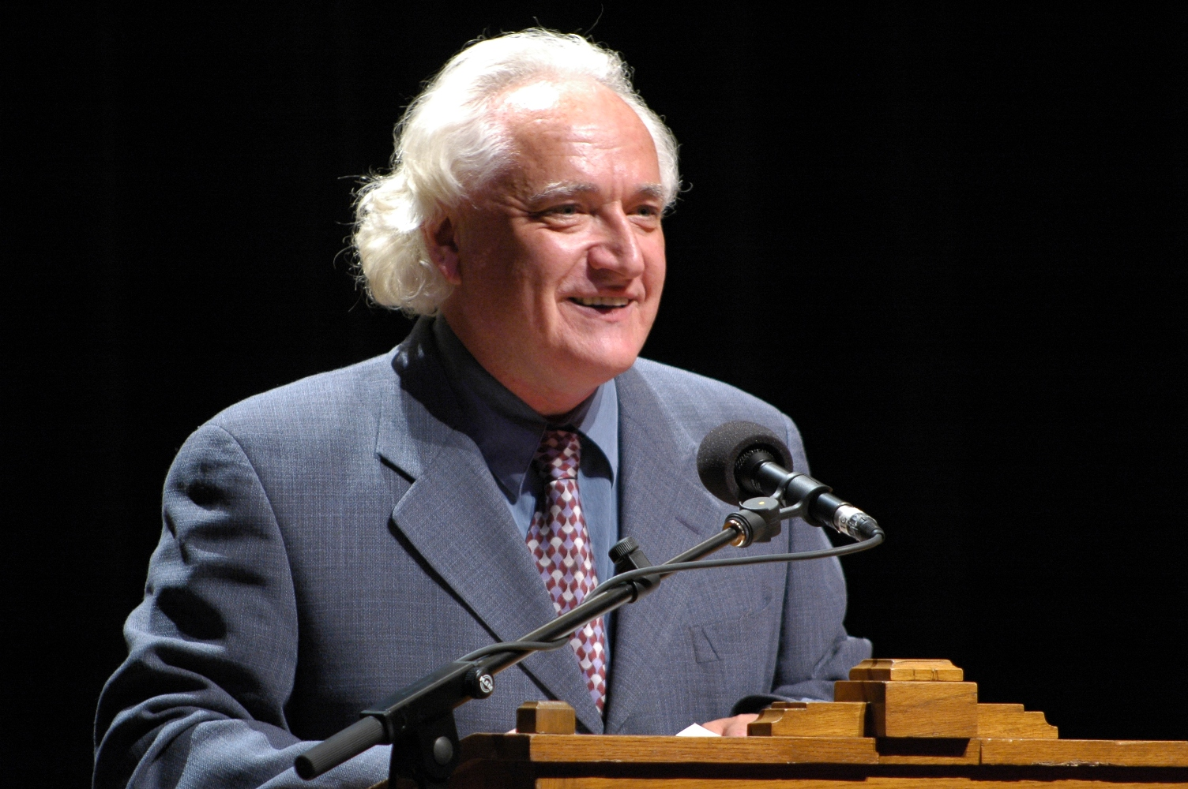
UBC-Laurier Institution Multiculturalism Lecture

Slide 10
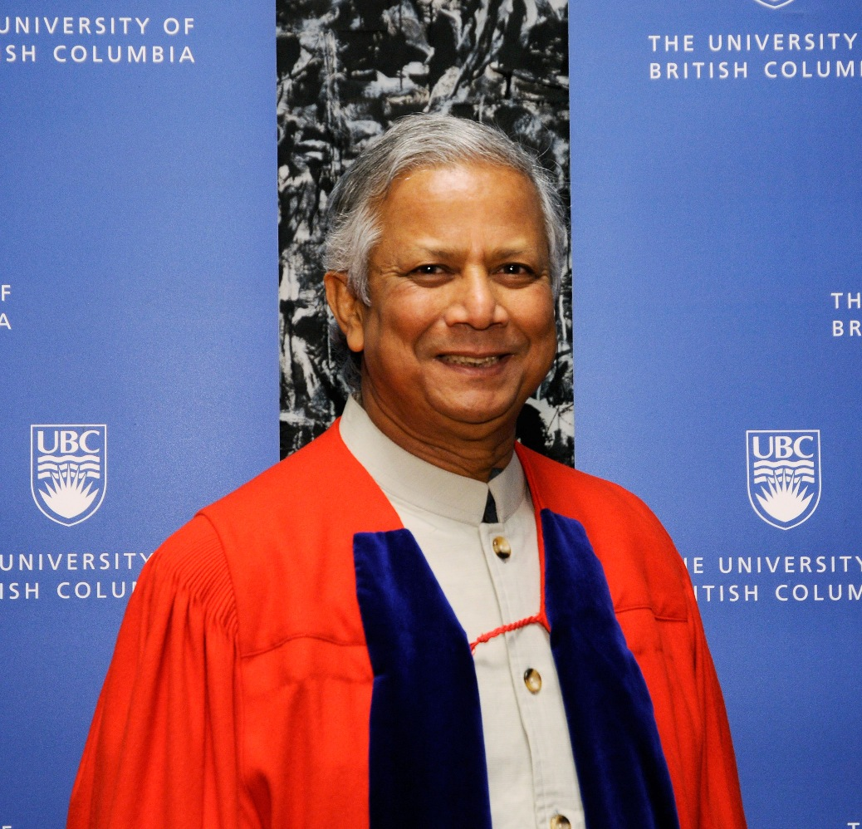
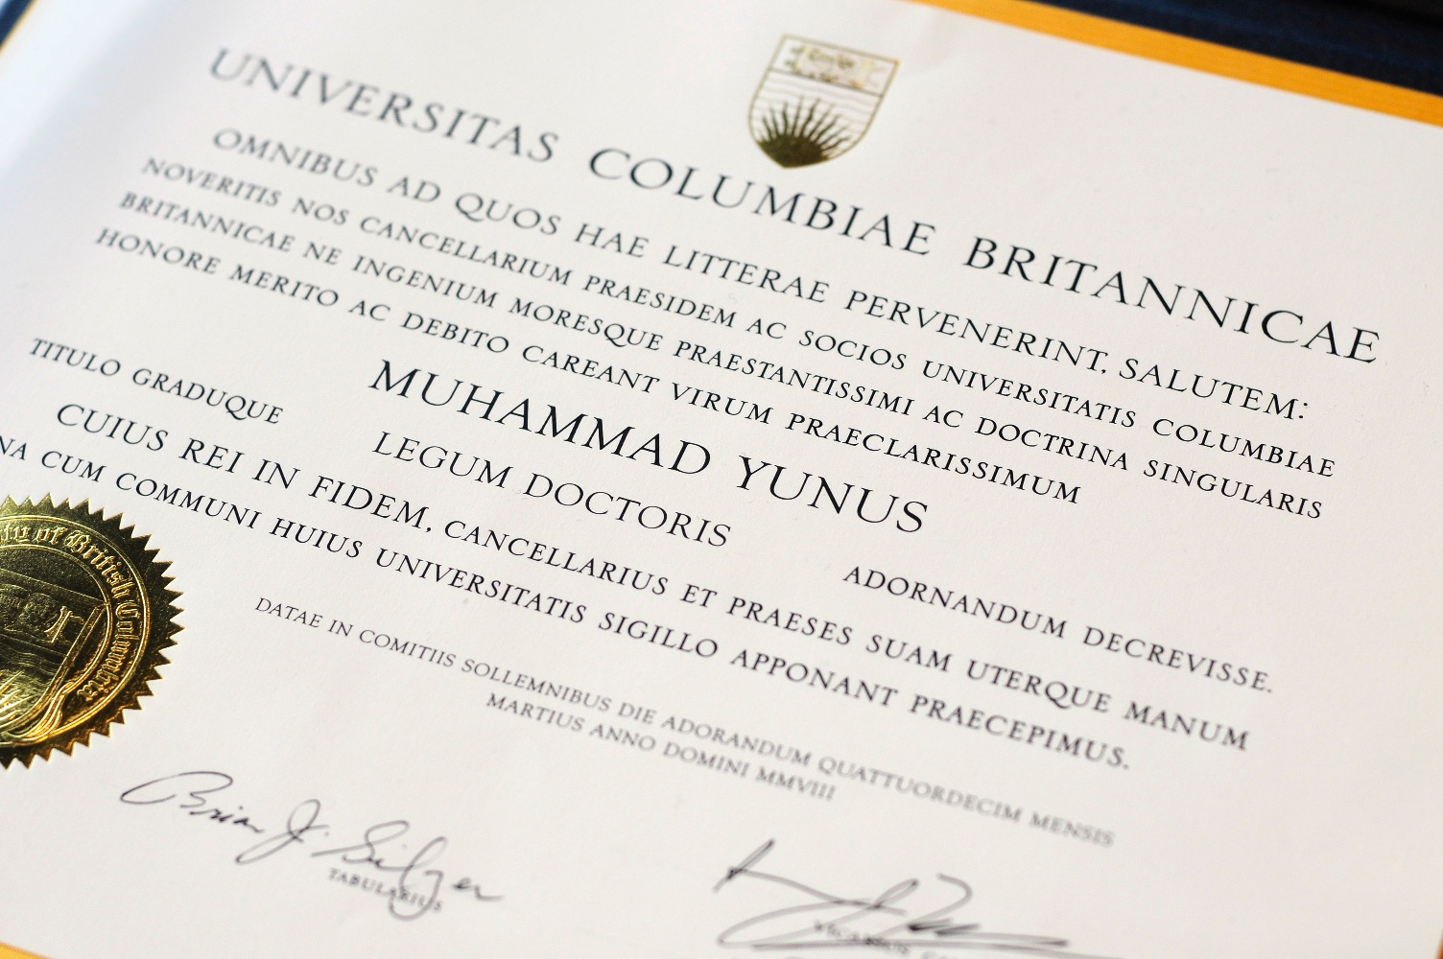
The Lectures:
Michael Smith Nobel Lecture Series
Created in honour of Nobel Prize-winning chemist Dr. Michael Smith, a
distinguished UBC professor of biochemistry. Lecture features Nobel Laureates
sharing their life experiences inside and beyond their focus of study.

Slide 11
The Lectures:
CBC Massey Lecture
A prestigious annual event in Canada, in which a noted Canadian or international
scholar gives a week-long series of lectures on a political, cultural or philosophical
topic. The lectures are broadcast nationally and internationally each November
on the CBC Radio.
Wade Davis 2009 - The Wayfinders: Why Ancient Wisdom Matters
in the Modern World
Margaret Atwood 2008 – Payback and the Shadow Side of Wealth
Albert Manguel 2007 – The City of Words
Margaret Somerville 2006 – The Ethical Imagination
Stephen Lewis 2005 – Race Against Time

Slide 12


CBC Massey Lectures

Slide 13
2. Celebrate Research Week:
Premise
To explore the length and breadth of research of UBC and affiliated
institutions

Slide 14
2. Celebrate Research Week:
Overview of the week
Events submitted from the Faculties and departments
We help with publicity and organization
We add key programming, in particular at the downtown campus
(Robson Square)

Slide 15
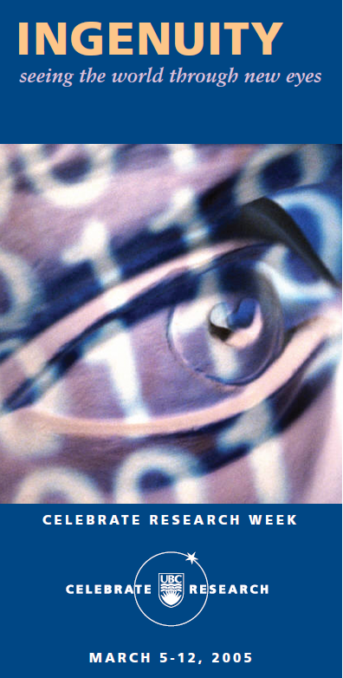

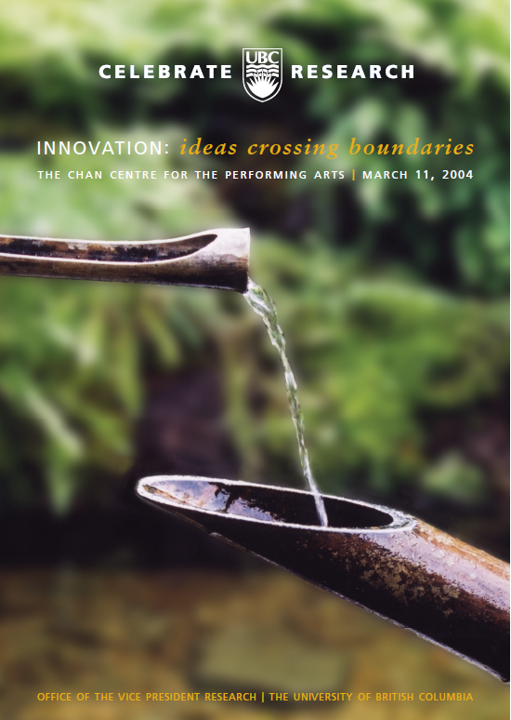
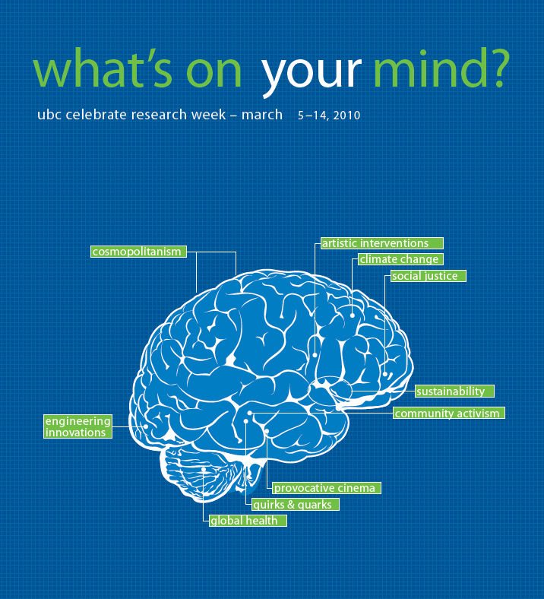
2. Celebrate Research Week:
Themes

Slide 16


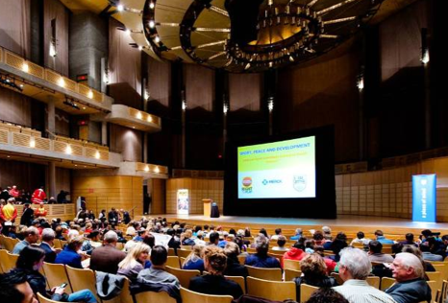
2. Celebrate Research Week:
Key Events
2010
  Sport and Society Dialogues associated with Olympic/Paralympic games
  Quirks and Quarks Question show

Slide 17
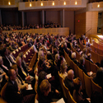
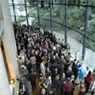
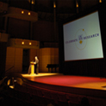
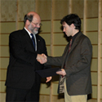
2. Celebrate Research Week:
Key Events
Previous Years
  Royal Commission on the Future of Health Care (Roy Romanow)
  Royal Society Symposium on Clean Energy
  The annual Gala

Slide 18

3. Major Opportunities
2006 HABITAT World Urban Forum
  In commemoration of the 30th anniversary of first conference
  Key events:
    Symposium on ‘Sport for Peace’
    Earth Village – to create an atmosphere of dialogue about
    cities and sustainability via music, dance, & theatre

Slide 19

3. Major Opportunities
UBC 2008 Centenary Celebrations
  100 years since signing of the charter
  Organized activities related to the work of University

Slide 20
3. Major Opportunities
Centenary Celebrations
  Key events:
    Visit of Mohammed Yunis
    Michael Smith Nobel Lecture
    Meeting with local ‘small business’ entrepreneurs
    Meeting with First Nations leaders
    Land of the Headhunters – 1914 film by Edward Curtis
    Gala with Ben Heppner and the CBC Radio Orchestra
    Commissioned musical piece for orchestra and chorus.
    Nominated for a Juno Award (Canadian Grammy)

Slide 21
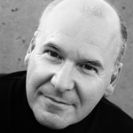

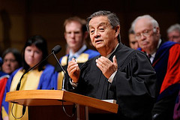
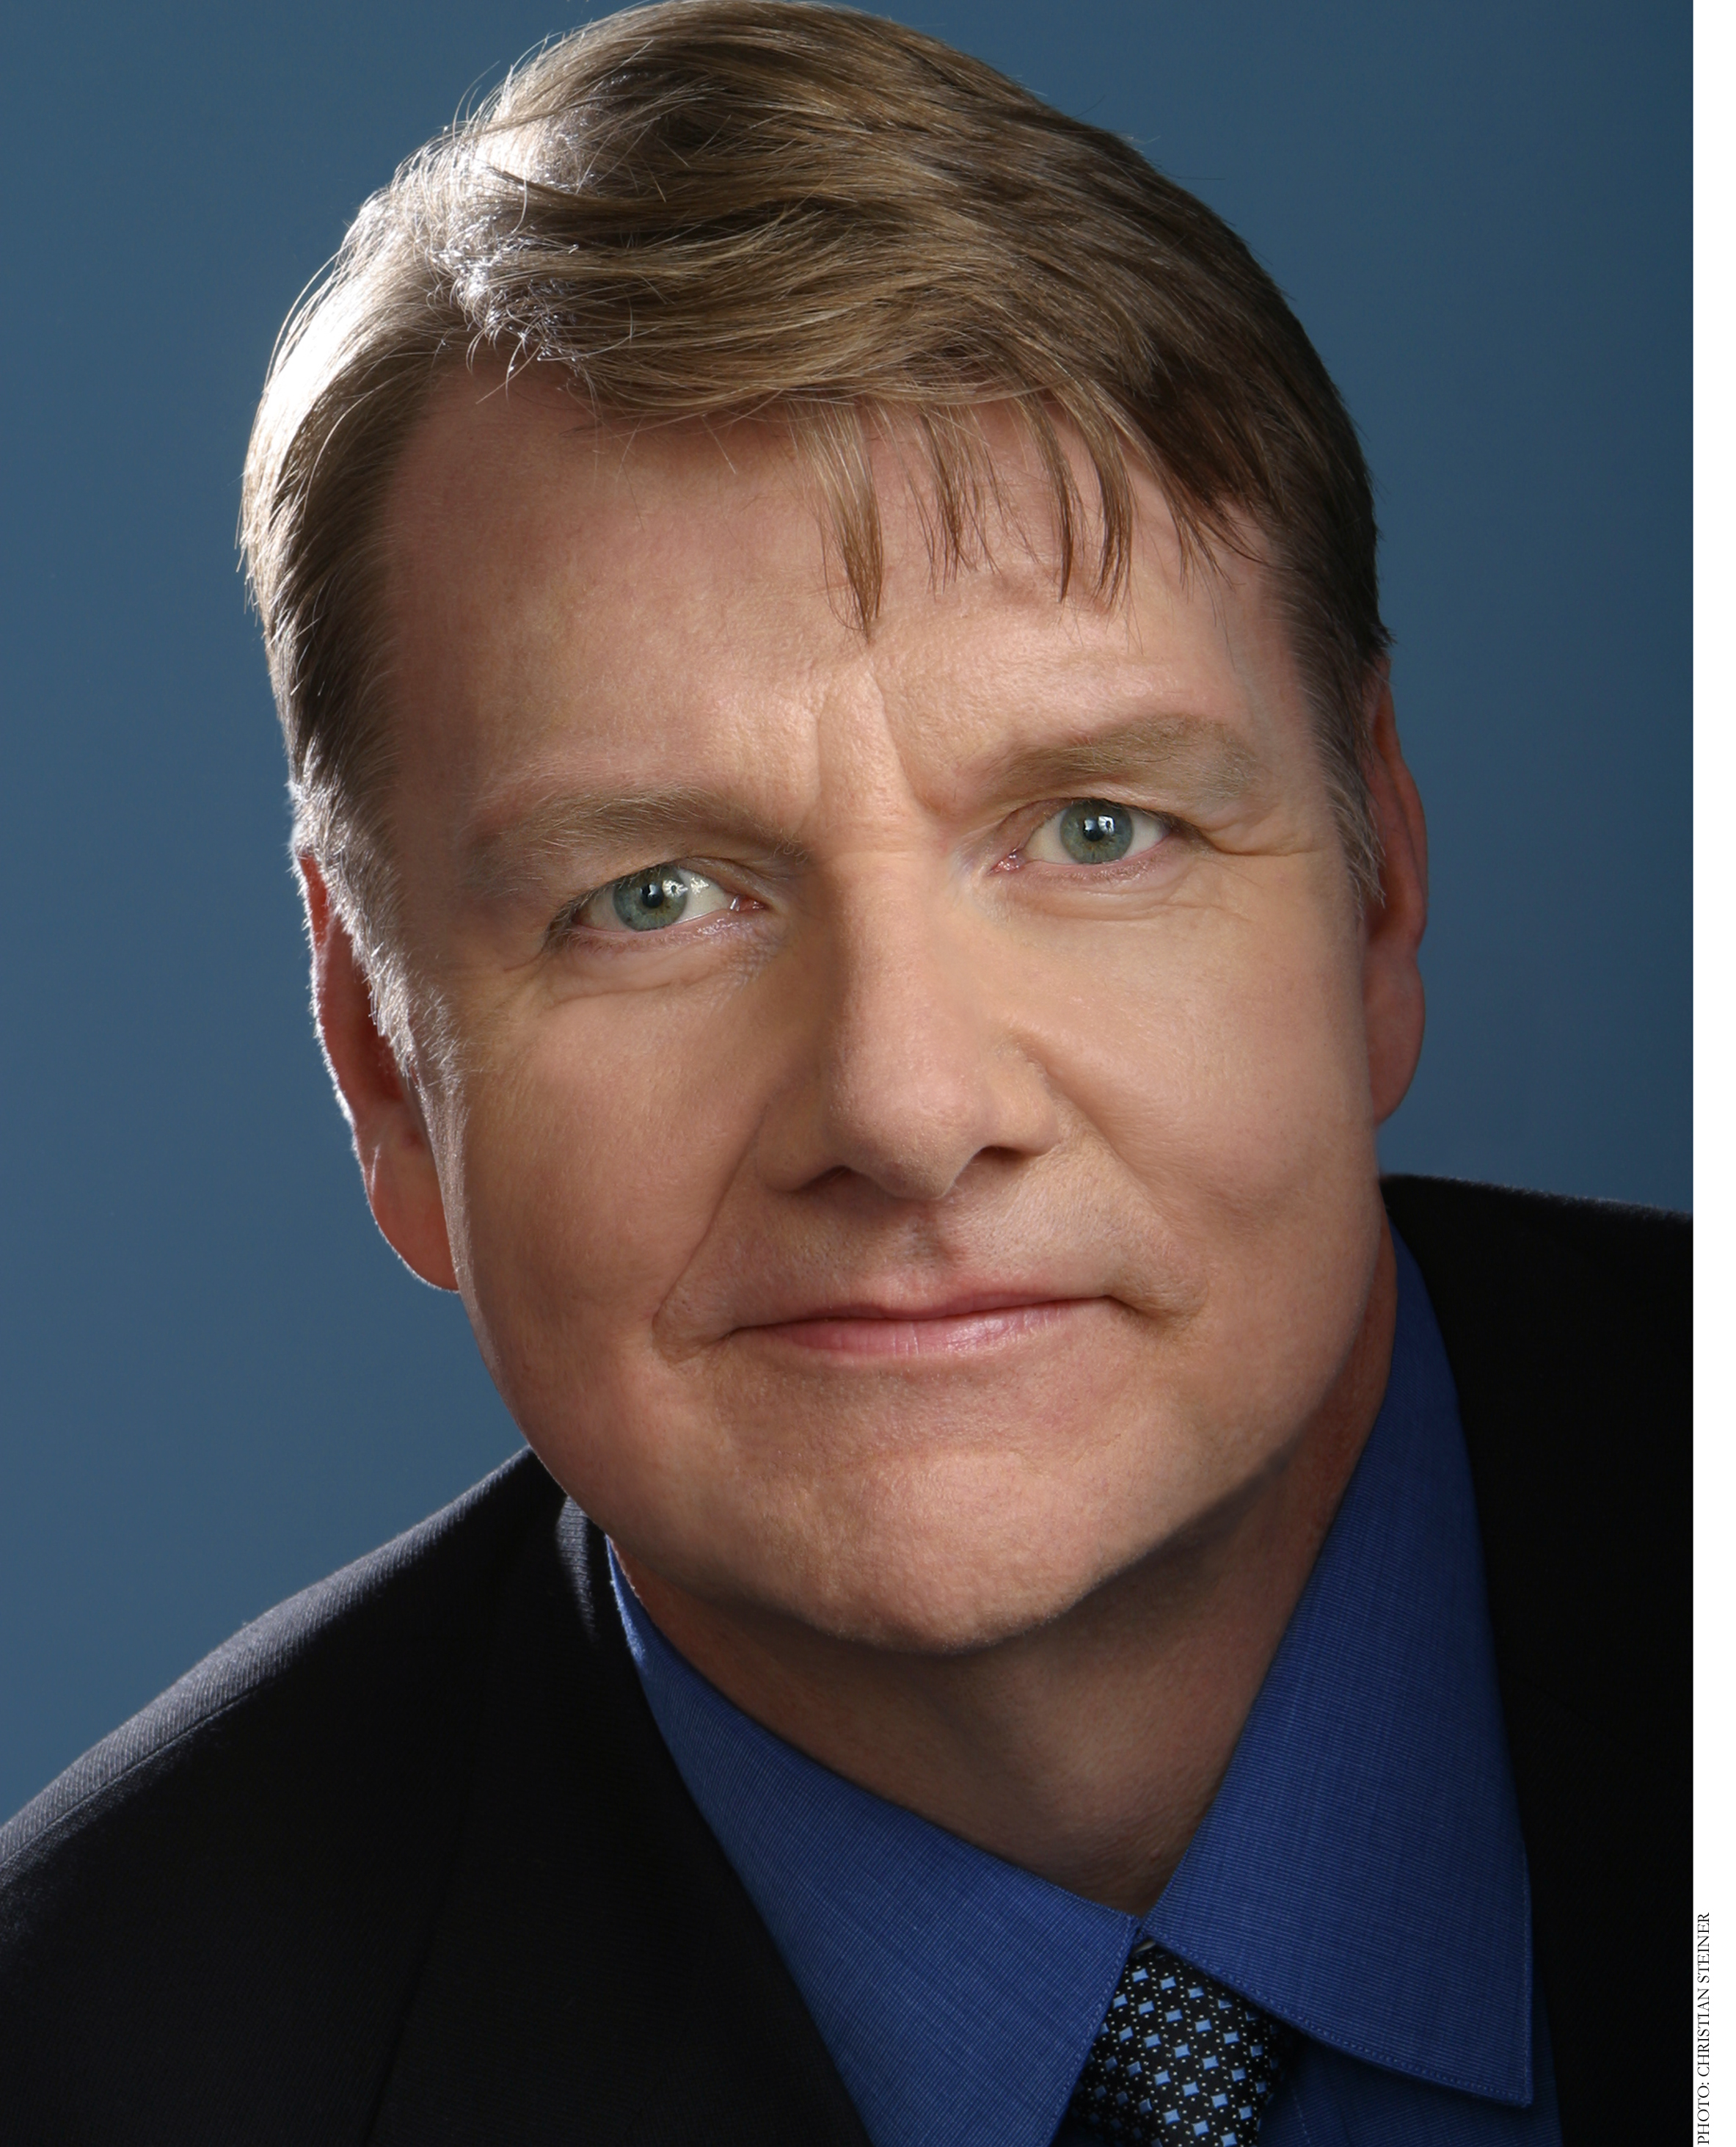
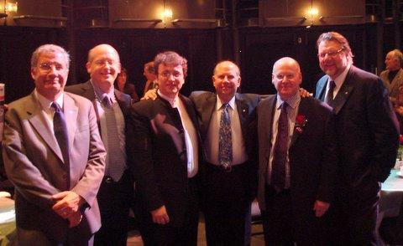
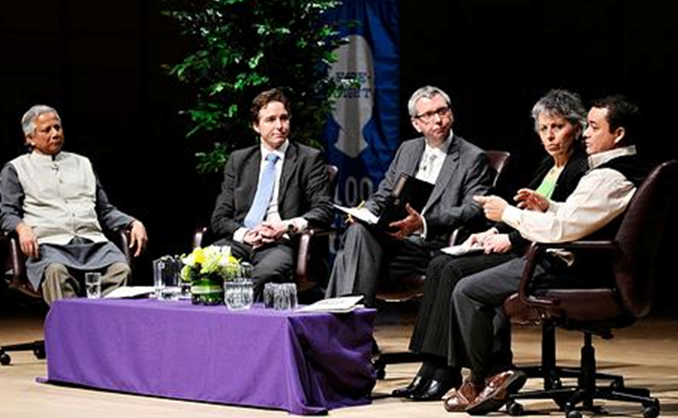
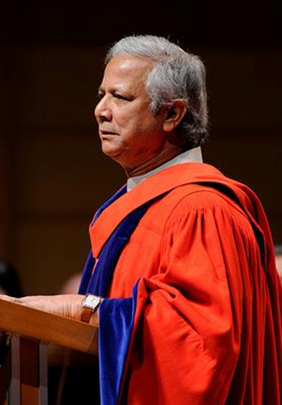
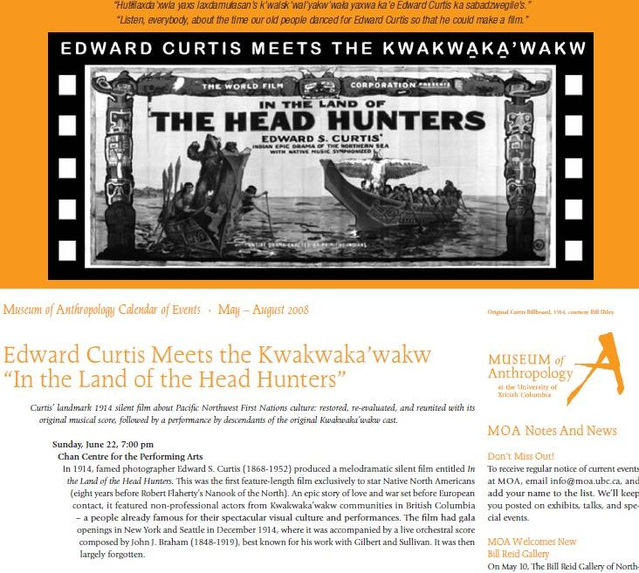
3. Major Opportunities
Centenary Celebrations

Slide 22
3. Major Opportunities
C. Olympic/Paralympic Education Program
Dialogues on key issues associated with the Olympics/Paralympics
Feature Olympians and Paralympians who have used their celebrity to
  make a difference to the games
To ask and answer the key questions associated with the Olympic Games
Key Note speakers include:
    Richard Pound
    Stephen Lewis
    Johann Olav Koss
    Bruce Kidd
    Wilfried Lemke

Slide 23
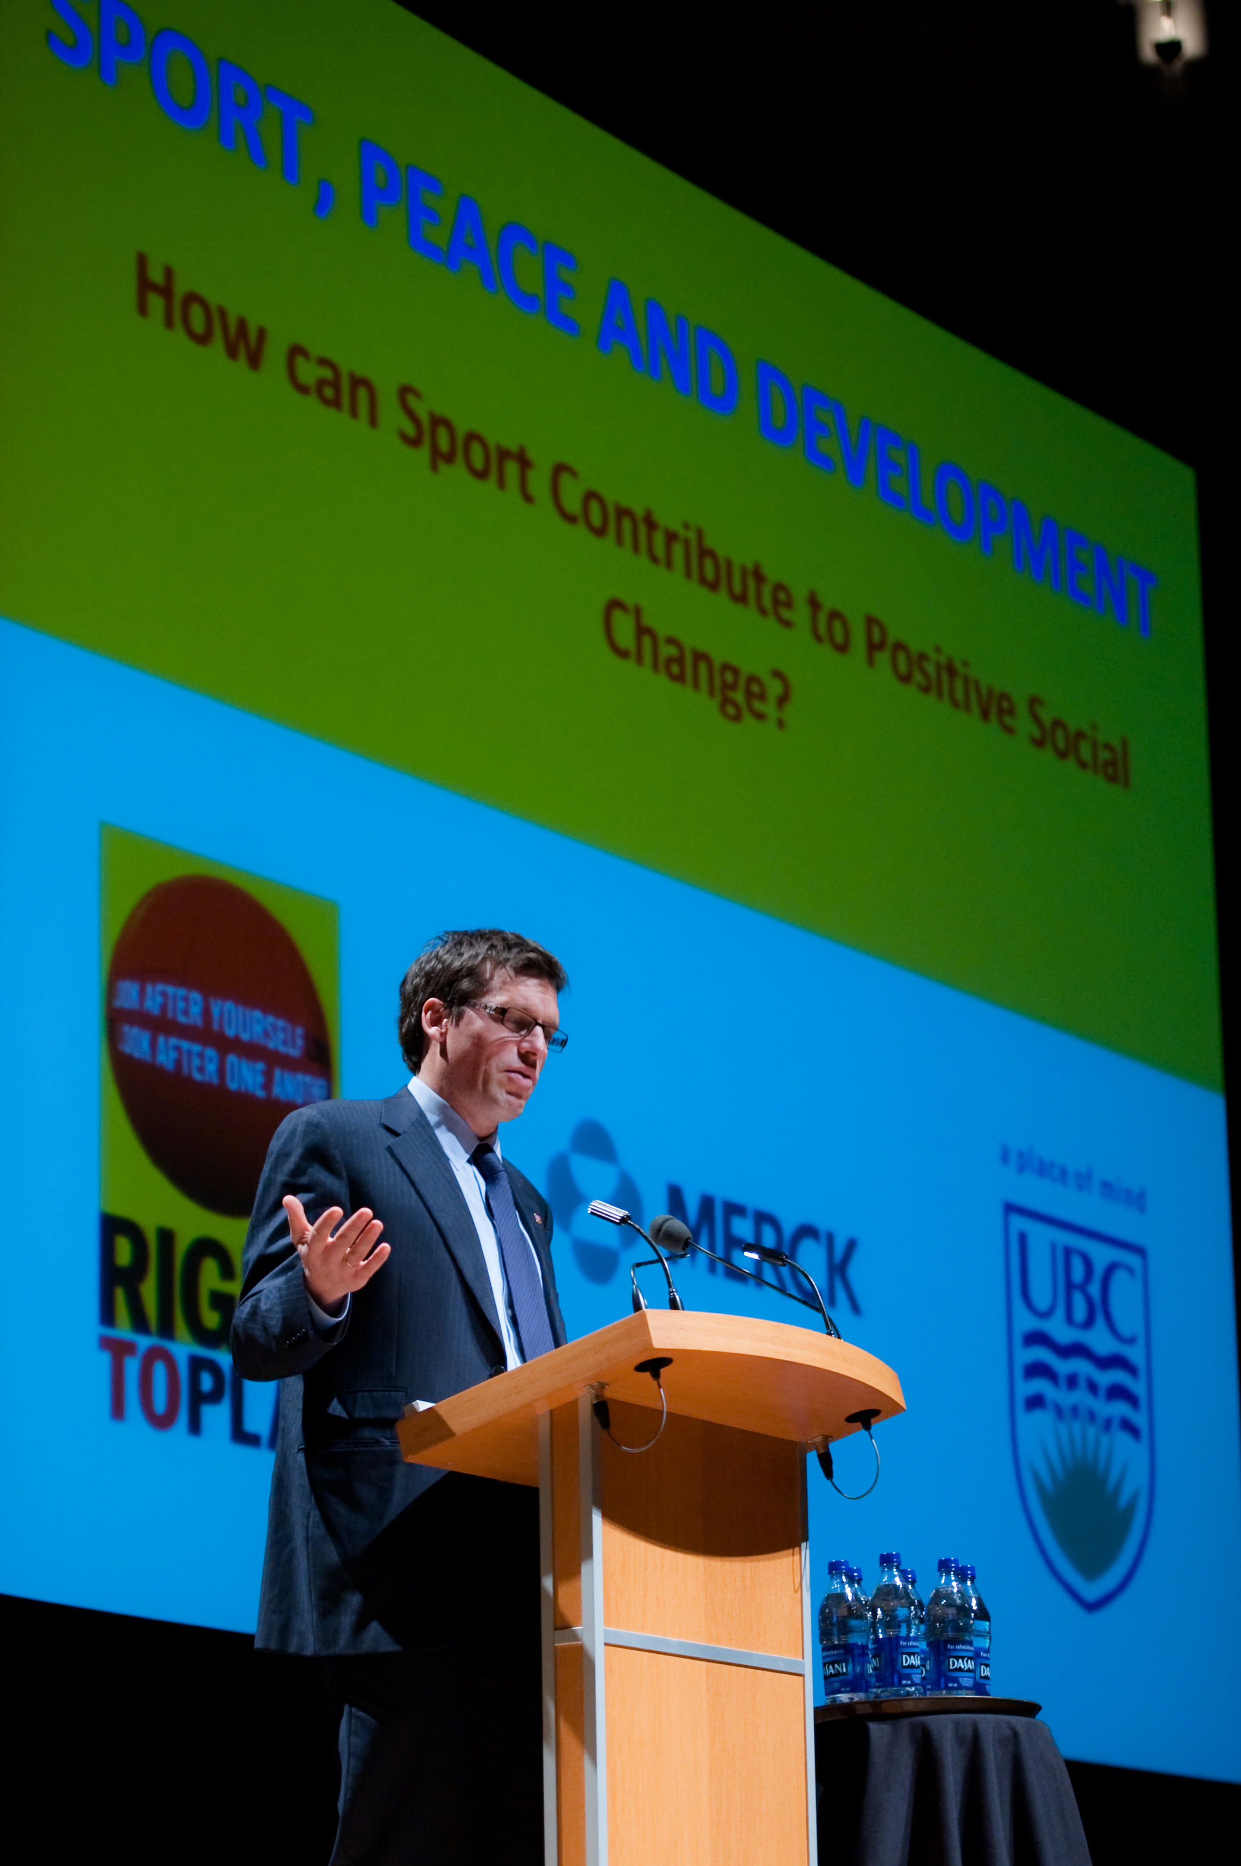
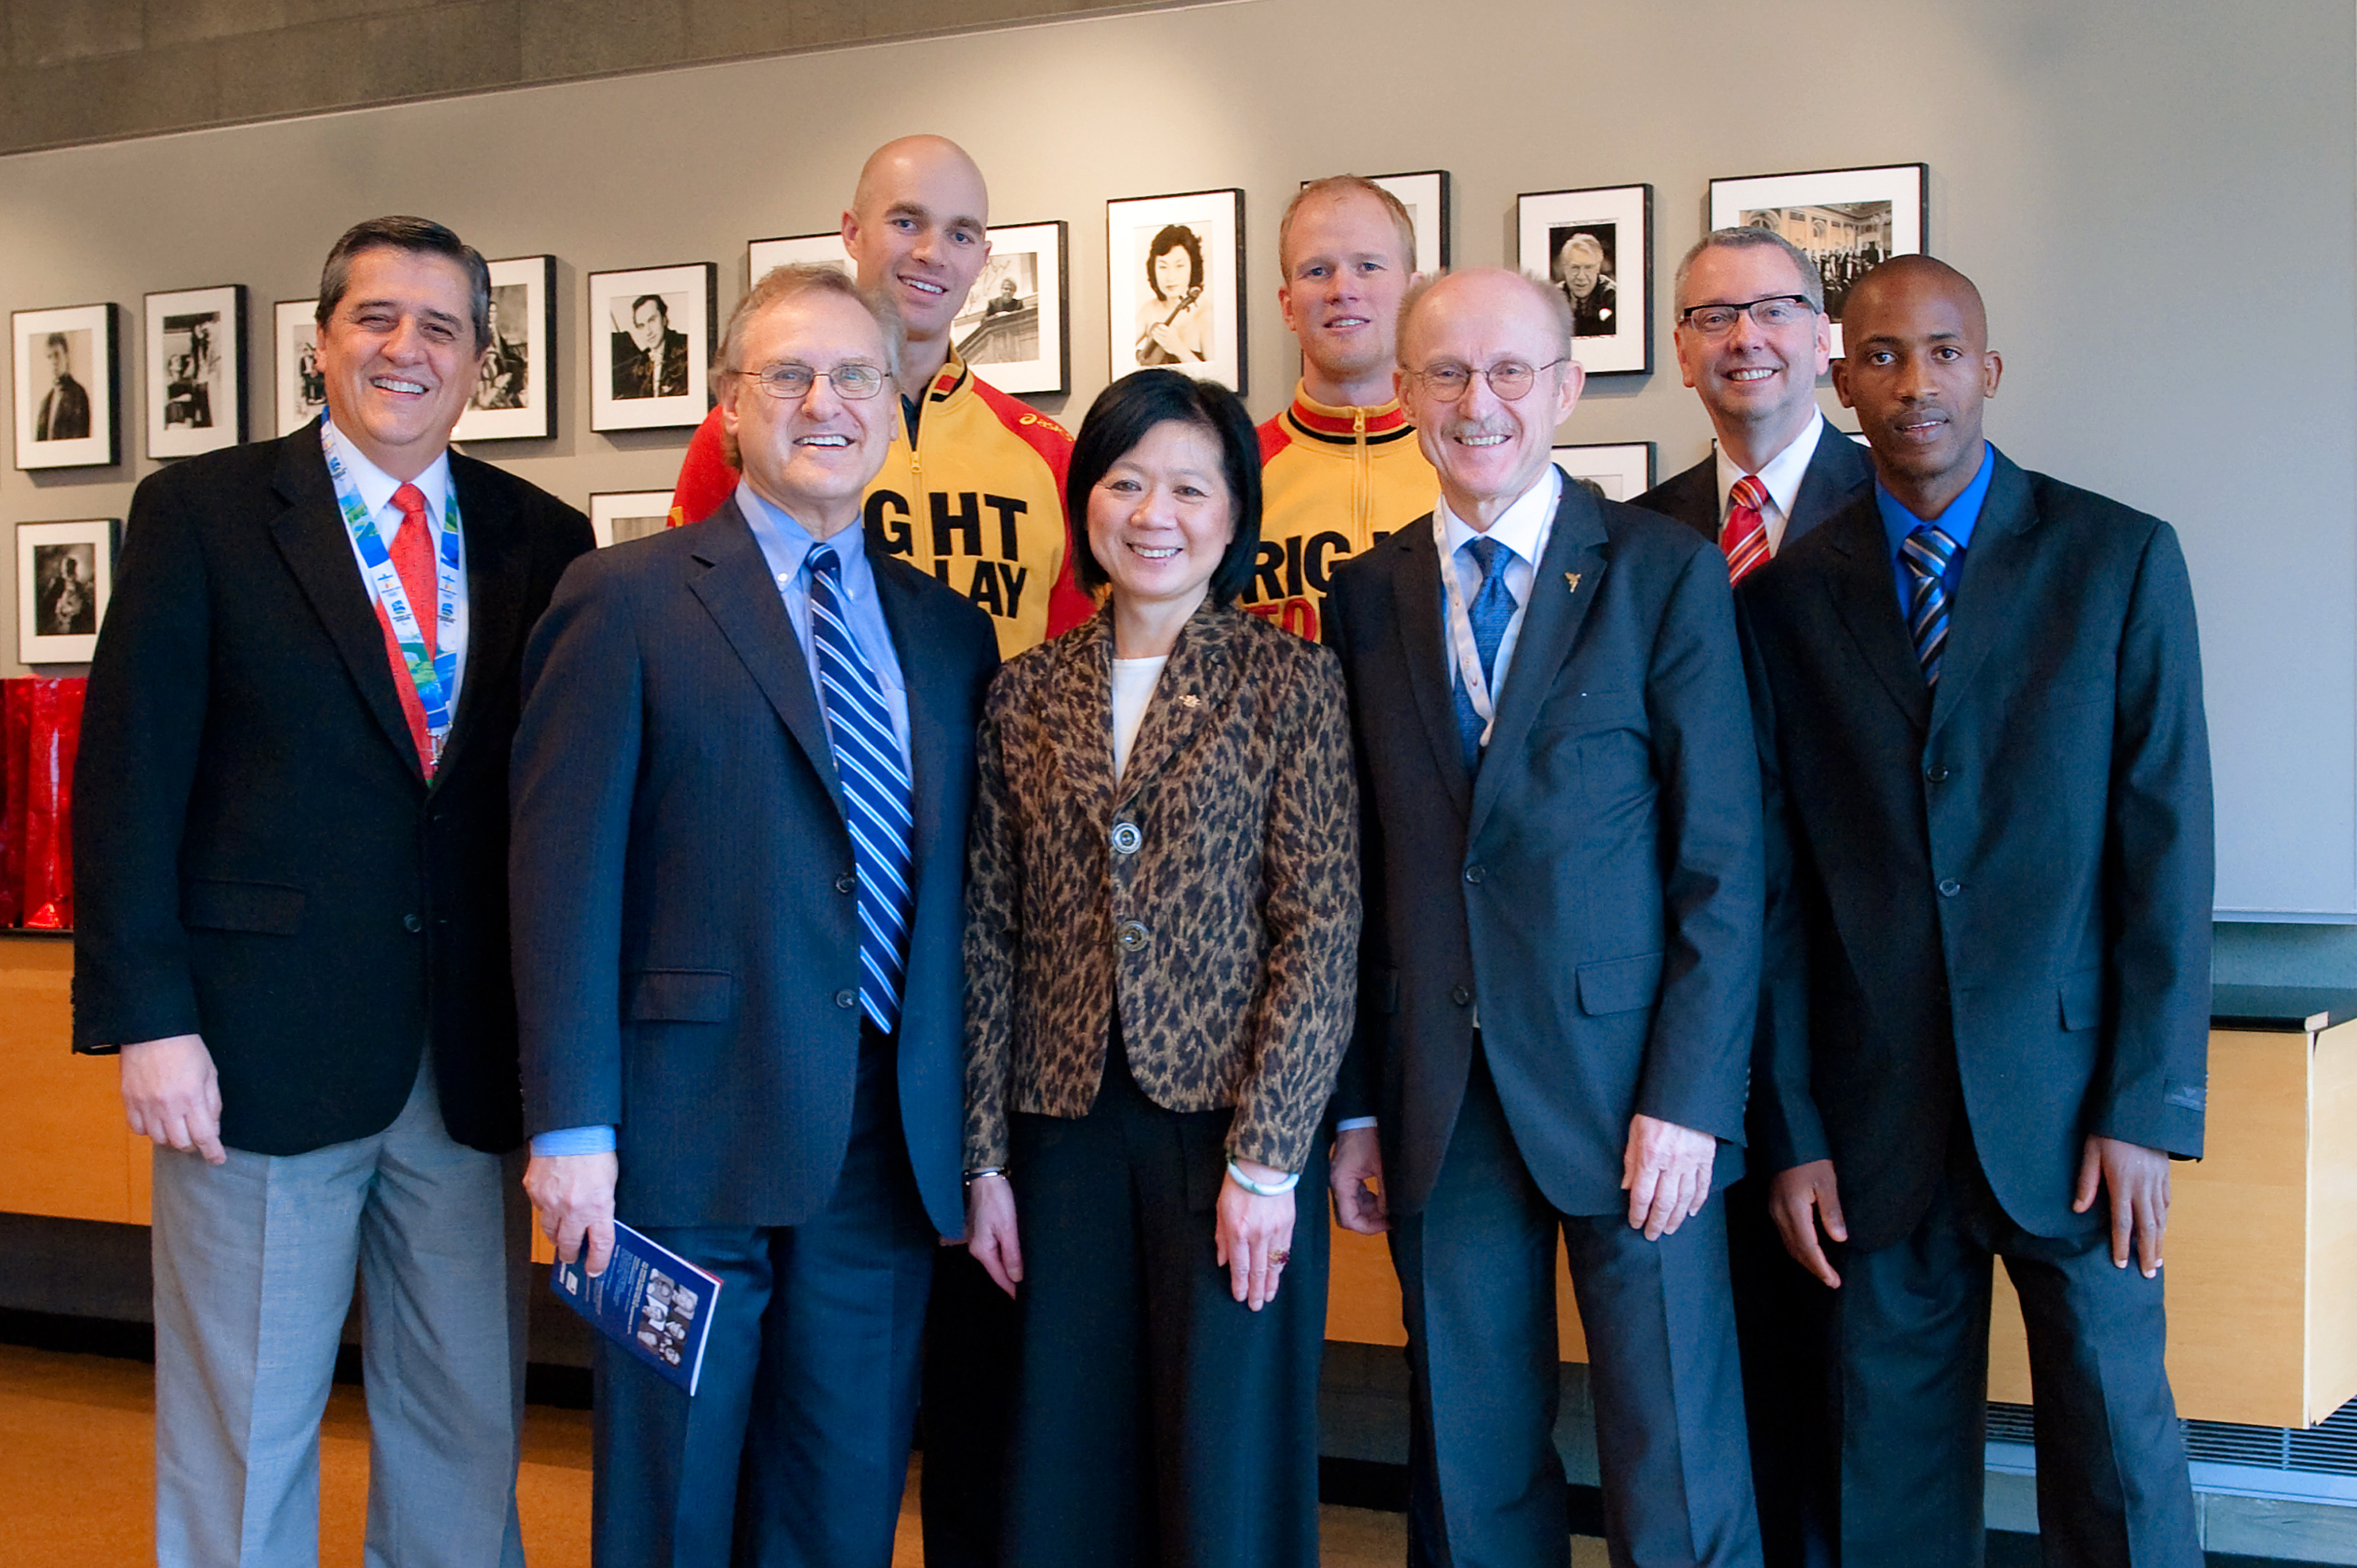
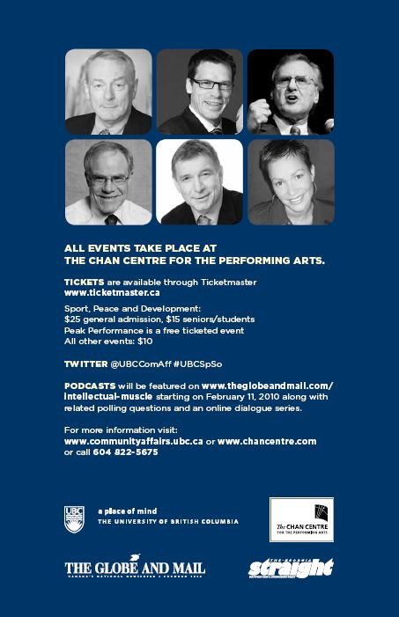
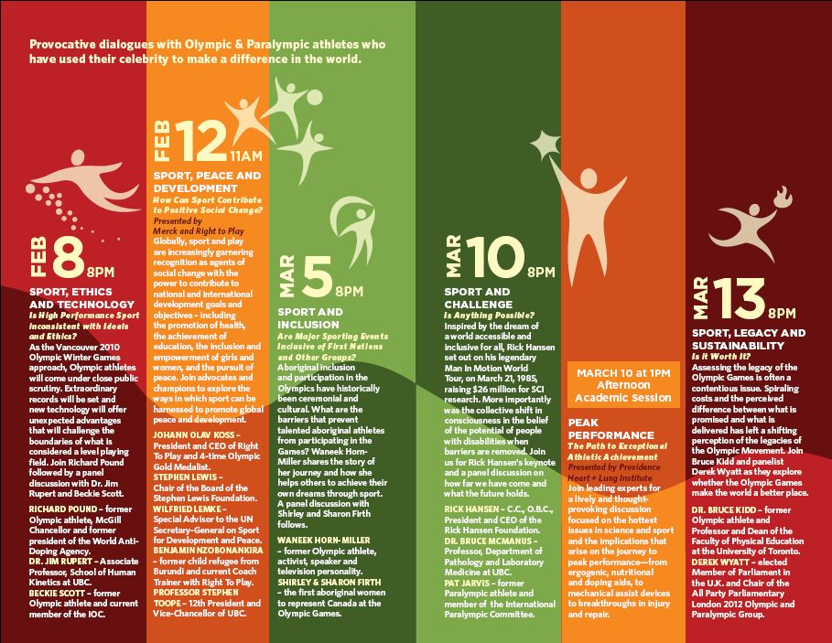
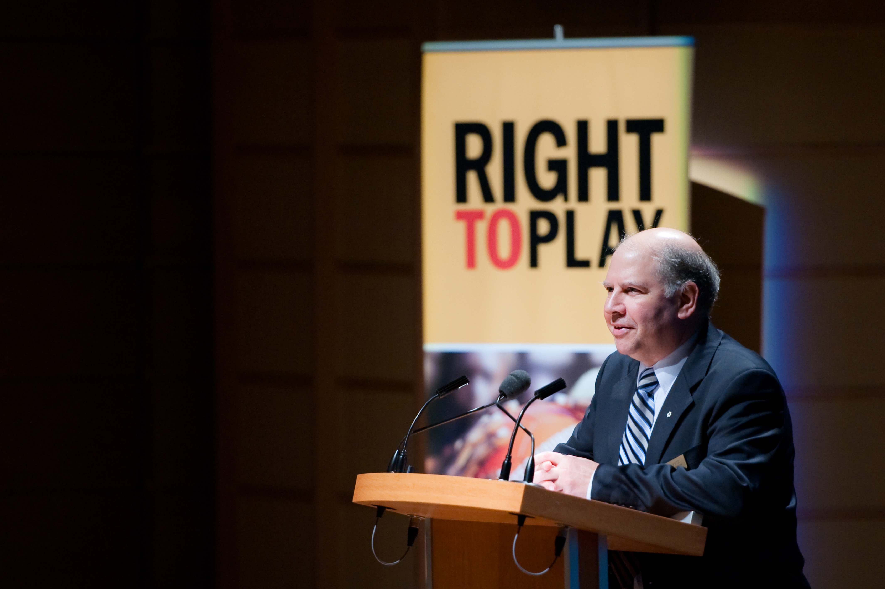
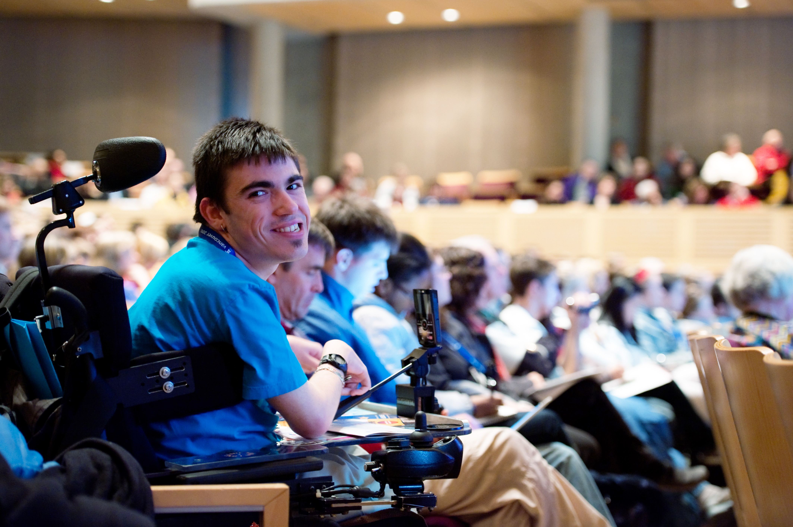
3. Major Opportunities
C. Olympic/Paralympic Education Program

Slide 24
4. First Nations Program
‘Bridge Through Sport’
  Started as a soccer tournament (visuals)
  Morphed into a literacy program
  Reading club
  Homework club
  Creative writing program
  Math/Science club
  Programs in the schools
  After school ‘no-homework’ club
  Primary years program incorporating First Nations language and culture

Slide 25
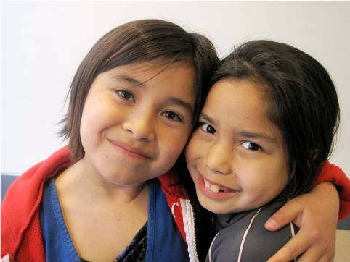
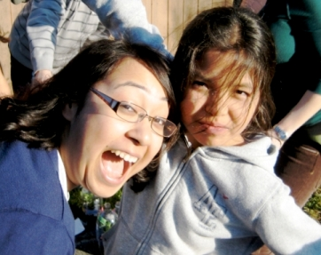
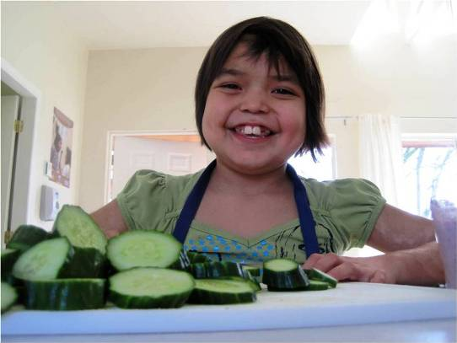
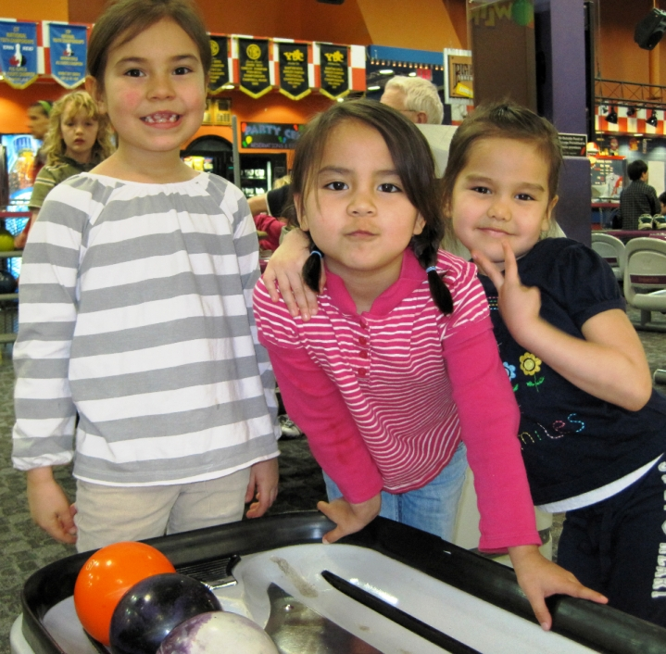
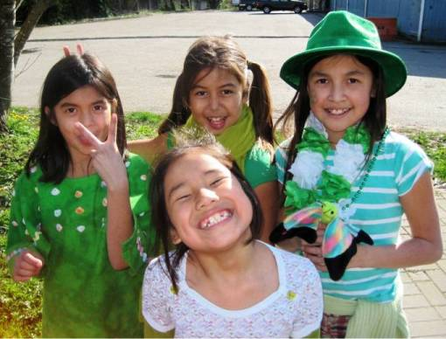
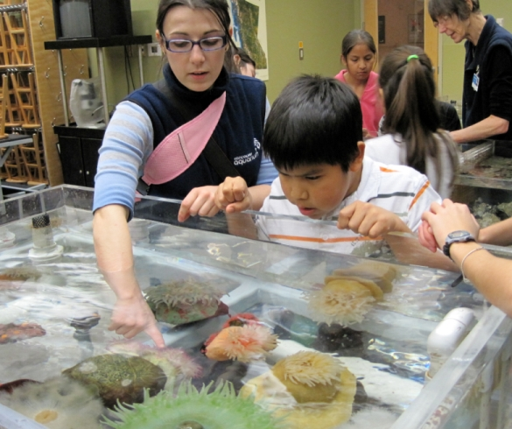
4. First Nations Program
‘Bridge Through Sport’

Slide 26
Summary
Where are we and where are we going?
How can these programs best be organized inside the University?
How do we pay for these programs?
How do we reward those who participate?

